Slide 1
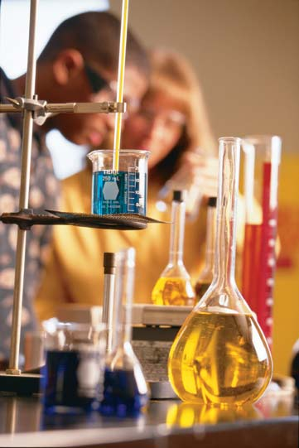
Biology Chapter 2
Chemistry
In
Biology

Slide 2
KEY CONCEPT Enzymes are catalysts for chemical reactions in living things.

Slide 3
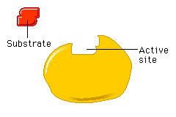
Objectives for section 2-5
Explain the effects of a catalyst on activation energy.
Elaborate on how enzymes allow chemical reactions to occur.

Slide 4
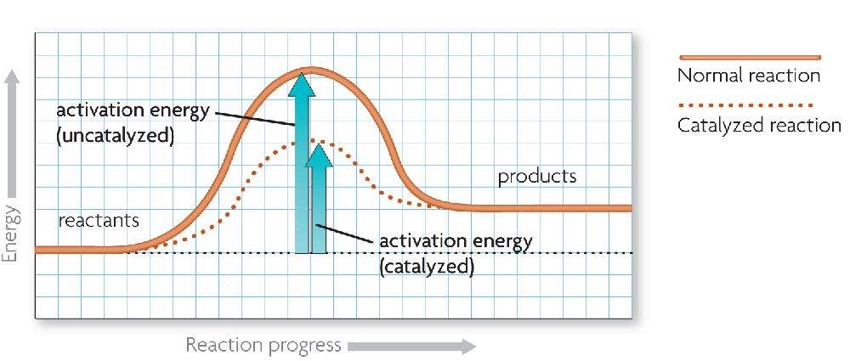
A catalyst lowers activation energy.
Catalysts are substances that speed up chemical reactions.
decrease activation energy
increase reaction rate (speeds it up)

Slide 5
Enzymes allow chemical reactions to occur under tightly controlled conditions.
Enzymes are catalysts in living things.
Enzymes are needed for almost all processes.
Most enzymes are proteins.

Slide 6
Disruptions in homeostasis can prevent enzymes from functioning.
Enzymes function best in a small range of conditions.
An enzyme’s function depends on its structure.

Slide 7
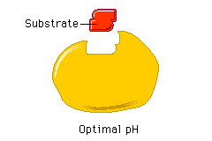
Changes in temperature and pH can break hydrogen bonds.

Slide 8
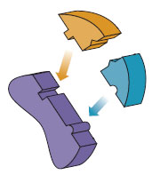
An enzyme’s structure allows only certain reactants to bind to the enzyme.
substrates
active site
substrates (reactants)
enzyme
Substrates bind to an enzyme at certain places called active sites.

Slide 9
The lock-and-key model helps illustrate how enzymes function.
substrates brought together
bonds in substrates weakened
Substrates bind to an enzyme at certain places called active sites.
The enzyme brings substrates together and weakens their bonds.
The catalyzed reaction forms a product that is released from the enzyme.

Slide 10
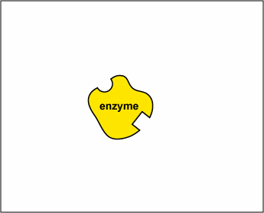

Slide 11
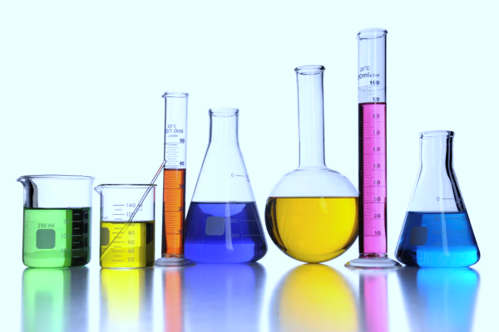
Quick Quiz Time!
Each question will be worth 2 points
You may NOT talk and/or communicate with a classmate
Scores will be collected and recorded at the end of the chapter

Slide 12
Trade your paper with a non-lab partner

