Slide 1
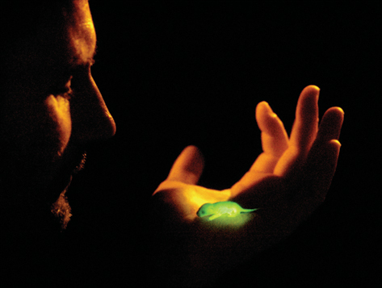
KEY CONCEPT DNA was identified as the genetic material through a series of experiments.

Slide 2
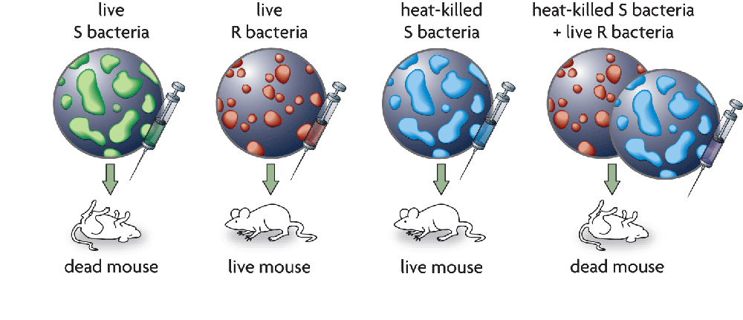
Griffith finds a ‘transforming principle.’
Griffith experimented with the bacteria that cause pneumonia.
He used two forms: the S form (deadly) and the R form (not deadly).
A transforming material passed from dead S bacteria to live R bacteria, making them deadly.

Slide 3
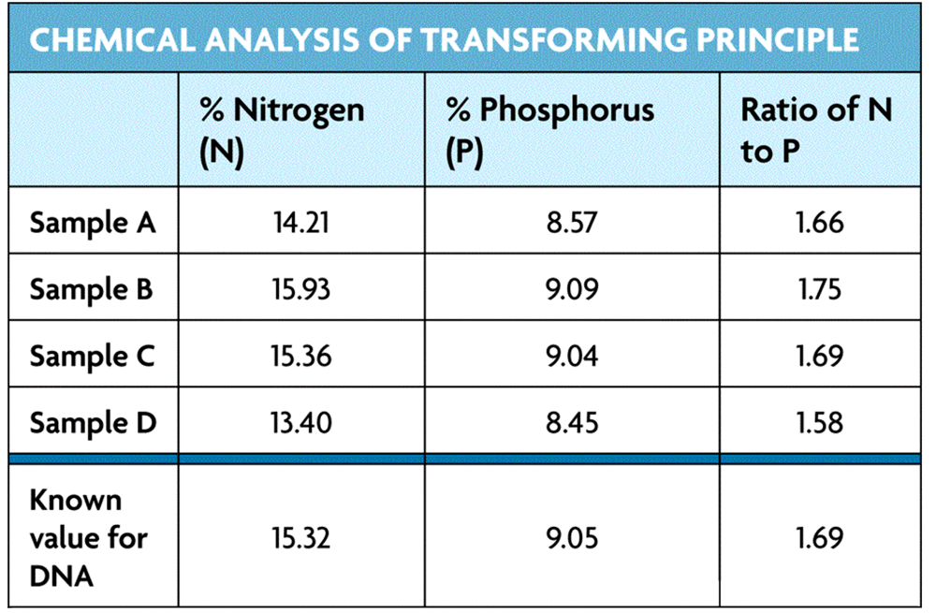
Avery identified DNA as the transforming principle.
Avery isolated and purified Griffith’s transforming principle.
Avery performed three tests on the transforming principle.
Qualitative tests showed DNA was present.
Chemical tests showed the chemical makeup matched that of DNA.
Enzyme tests showed only DNA-degrading enzymes stopped transformation.

Slide 4
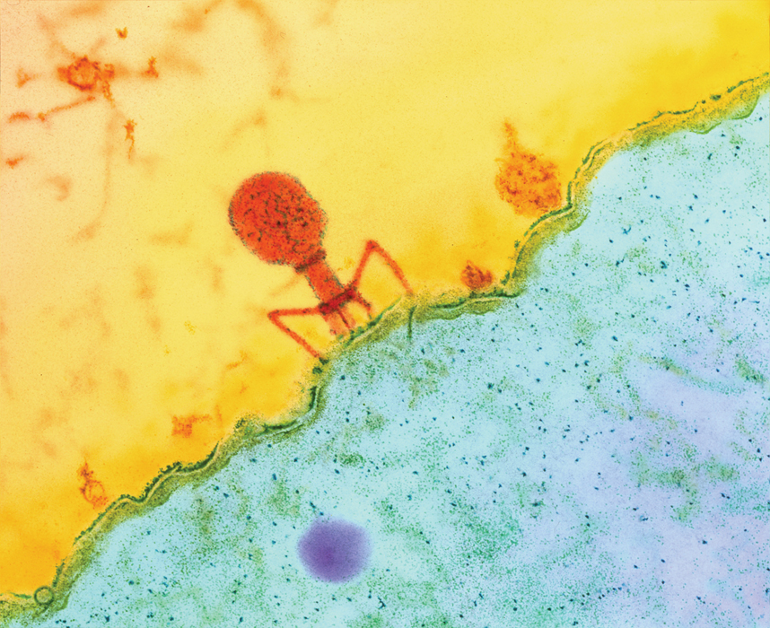
Hershey and Chase confirm that DNA is the genetic material.
Hershey and Chase studied viruses that infect bacteria, or bacteriophages.
They tagged viral DNA with radioactive phosphorus.
They tagged viral proteins with radioactive sulfur.
Tagged DNA was found inside the bacteria; tagged proteins were not.

Slide 5
KEY CONCEPT DNA structure is the same in all organisms.

Slide 6
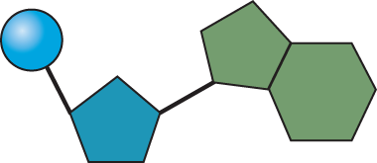
DNA is composed of four types of nucleotides.
DNA is made up of a long chain of nucleotides.
Each nucleotide has three parts.
a phosphate group
a deoxyribose sugar
a nitrogen-containing base
phosphate group
nitrogen-containing
base
deoxyribose (sugar)

Slide 7
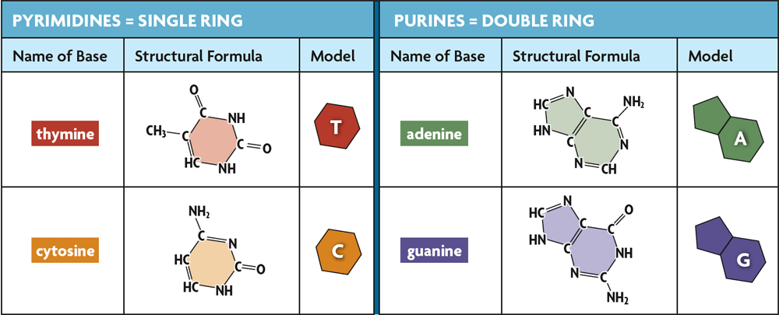
The nitrogen containing bases are the only difference in the four nucleotides.

Slide 8
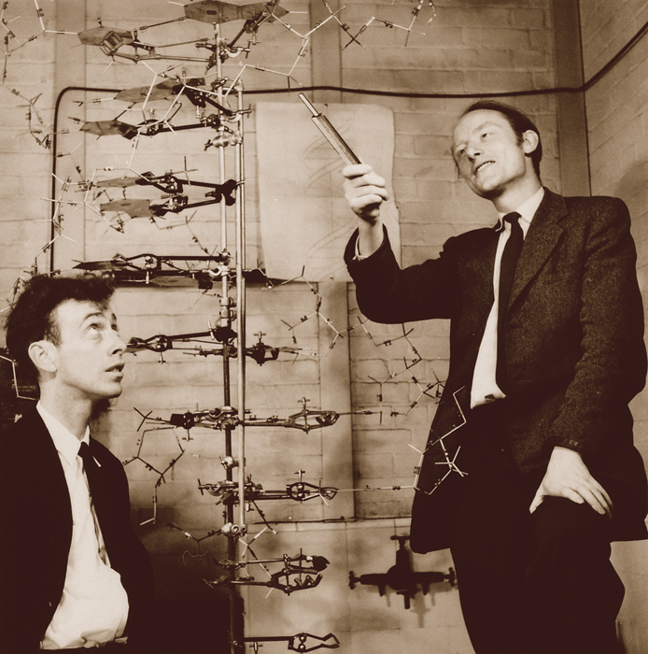
Watson and Crick determined the three-dimensional structure of DNA by building models.
They realized that DNA is a double helix that is made up of a sugar-phosphate backbone on the outside with bases on the inside.

Slide 9
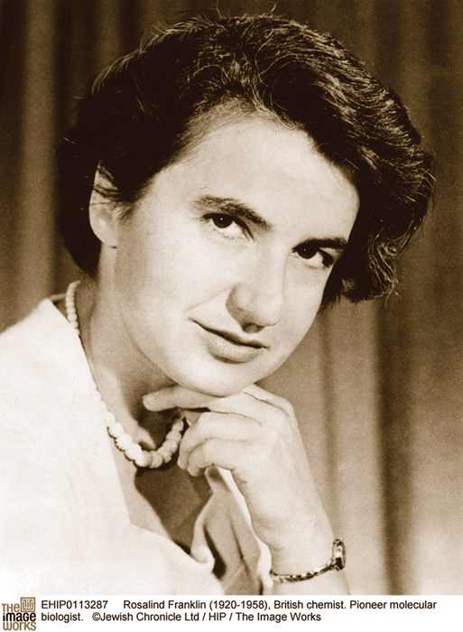
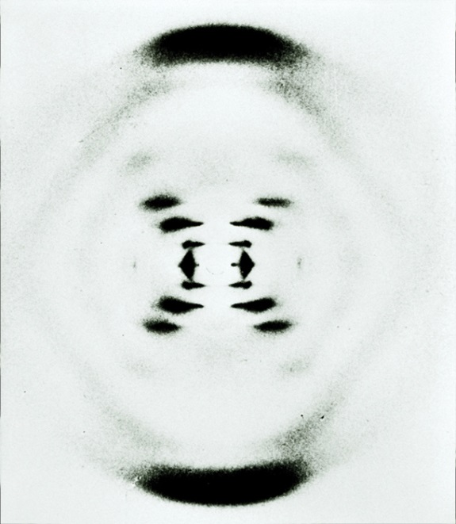
Watson and Crick’s discovery built on the work of Rosalind Franklin and Erwin Chargaff.
Franklin’s x-ray images suggested that DNA was a double helix of even width.
Chargaff’s rules stated that A=T and C=G.

Slide 10
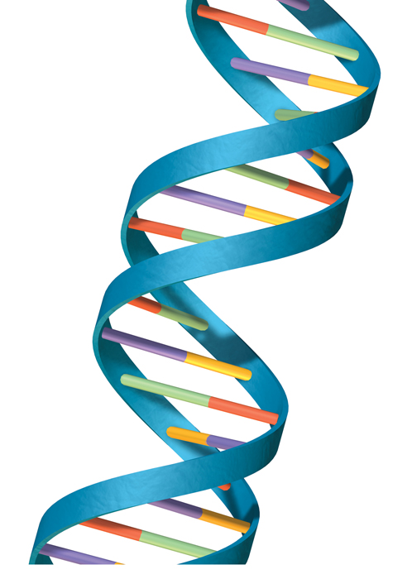
Nucleotides always pair in the same way.
The base-pairing rules show how nucleotides always pair up in DNA.
A pairs with T
C pairs with G
Because a pyrimidine (single ring) pairs with a purine (double ring), the helix has a uniform width.
G
C
A
T

Slide 11
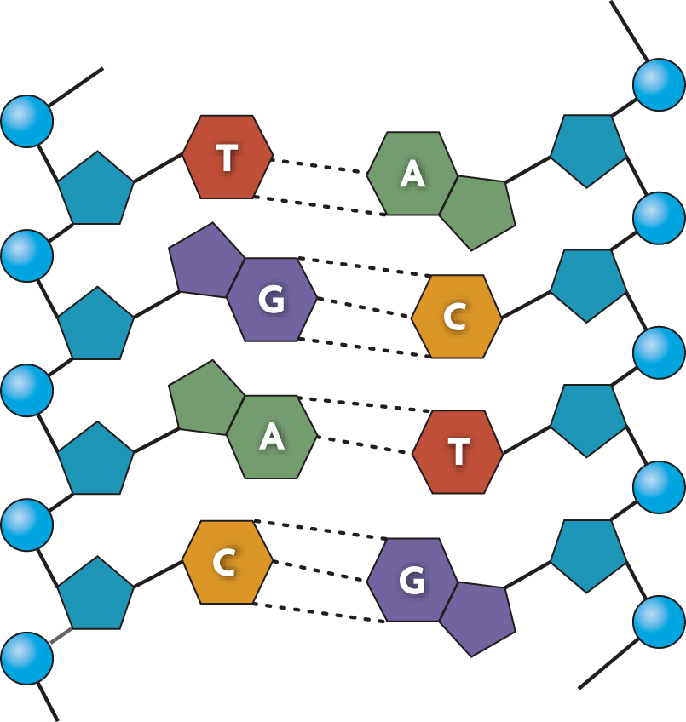
The backbone is connected by covalent bonds.
The bases are connected by hydrogen bonds.
hydrogen bond
covalent bond

Slide 12
KEY CONCEPT DNA replication copies the genetic information of a cell.

Slide 13
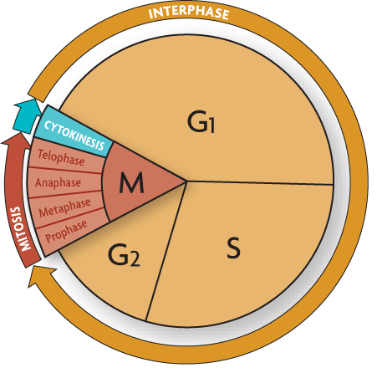
Replication copies the genetic information.
A single strand of DNA serves as a template for a new strand.
The rules of base pairing direct replication.
DNA is replicated during the S (synthesis) stage of the cell cycle.
Each body cell gets a complete set of identical DNA.

Slide 14
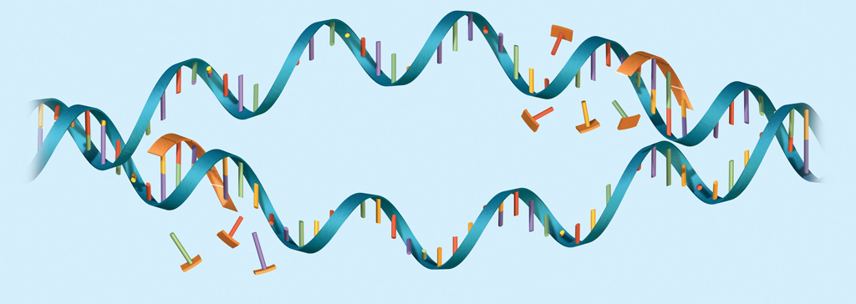
Proteins carry out the process of replication.
DNA serves only as a template.
Enzymes and other proteins do the actual work of replication.
Enzymes unzip the double helix.
Free-floating nucleotides form hydrogen bonds with the template strand.
nucleotide
The DNA molecule unzips in both directions.

Slide 15
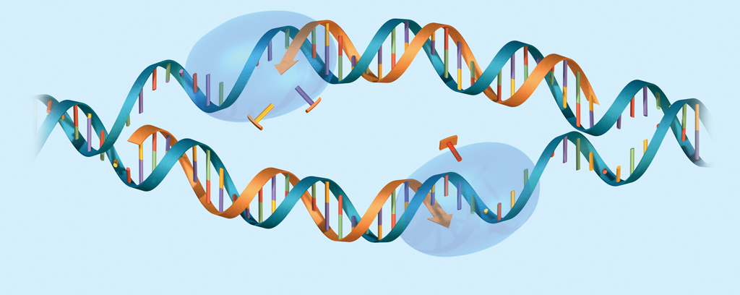
DNA polymerase enzymes bond the nucleotides together to form the double helix.
Polymerase enzymes form covalent bonds between nucleotides in the new strand.
new strand
nucleotide
DNA polymerase

Slide 16
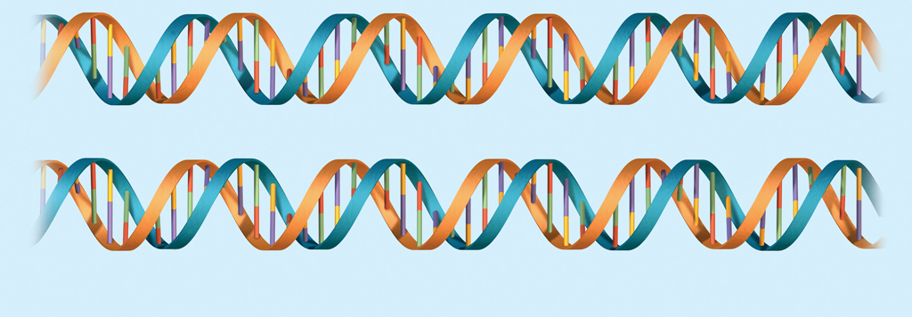
Two new molecules of DNA are formed, each with an original strand and a newly formed strand.
DNA replication is semiconservative.
original strand
new strand
Two molecules of DNA

Slide 17
KEY CONCEPT Transcription converts a gene into a single-stranded RNA molecule.

Slide 18
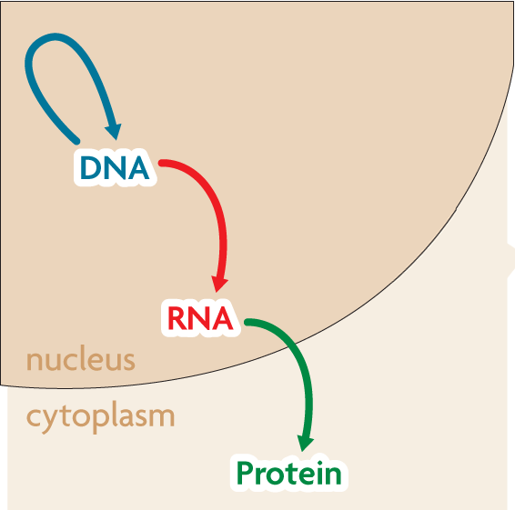
RNA carries DNA’s instructions.
The central dogma states that information flows in one direction from DNA to RNA to proteins.

Slide 19
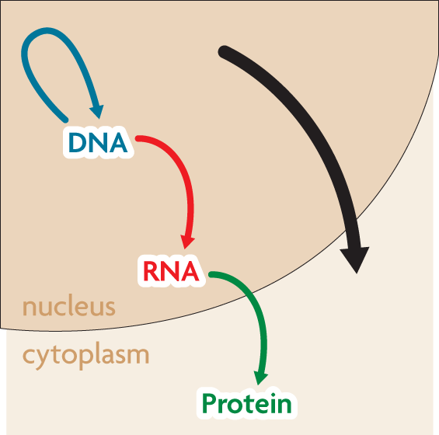
The central dogma includes three processes.
Replication
Transcription
Translation
replication
RNA is a link between DNA and proteins.
transcription
translation

Slide 20
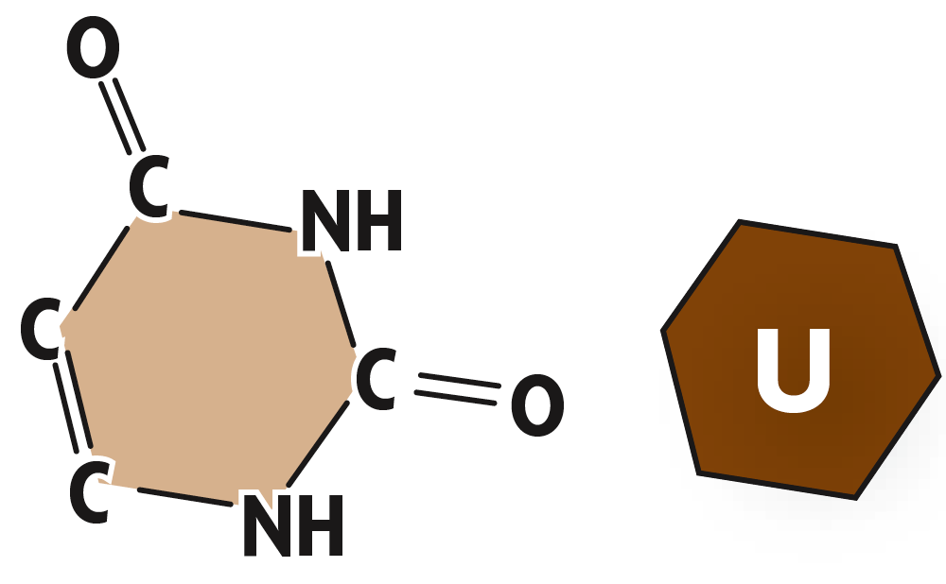
RNA differs from DNA in three major ways.
RNA has a ribose sugar.
RNA has uracil instead of thymine.
RNA is a single-stranded structure.

Slide 21
Transcription makes three types of RNA.
Transcription copies DNA to make a strand of RNA.

Slide 22
KEY CONCEPT Translation converts an mRNA message into a polypeptide, or protein.

Slide 23
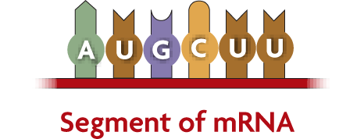
Amino acids are coded by mRNA base sequences.
Translation converts mRNA messages into polypeptides.
A codon is a sequence of three nucleotides that codes for an amino acid.
codon for
methionine (Met)
codon for
leucine (Leu)

Slide 24
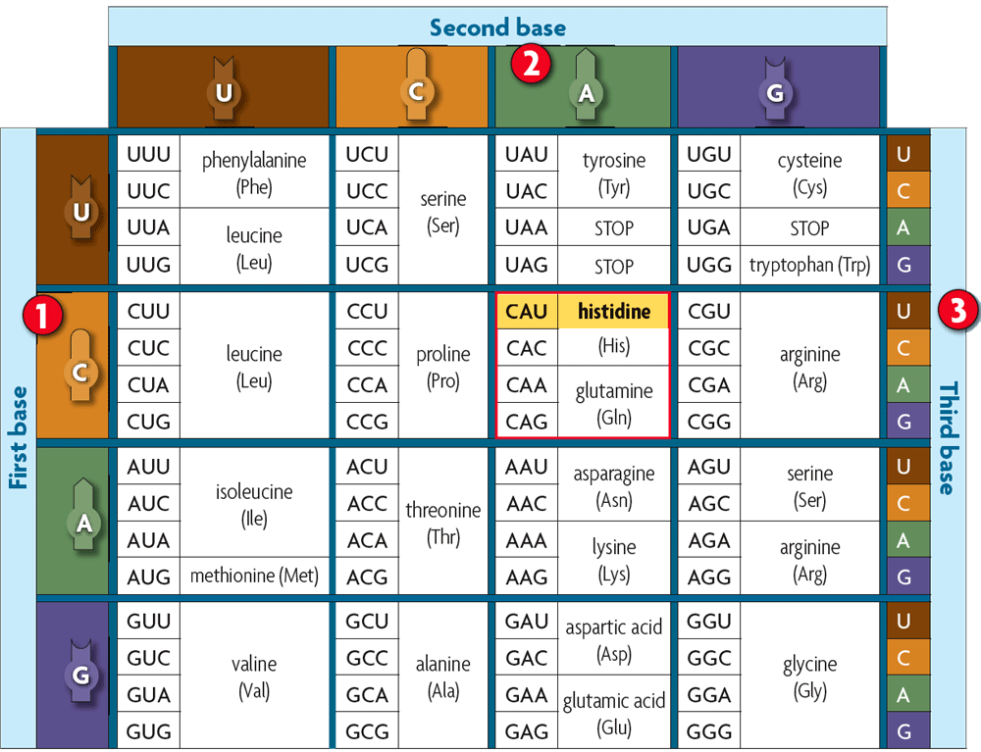
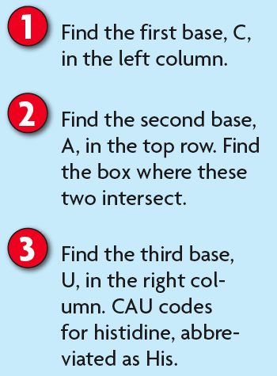
The genetic code matches each codon to its amino acid or function.
The genetic code matches each RNA codon with its amino acid or function.
three stop codons
one start codon, codes for methionine

Slide 25
A change in the order in which codons are read changes the resulting protein.
Regardless of the organism, codons code for the same amino acid.

Slide 26
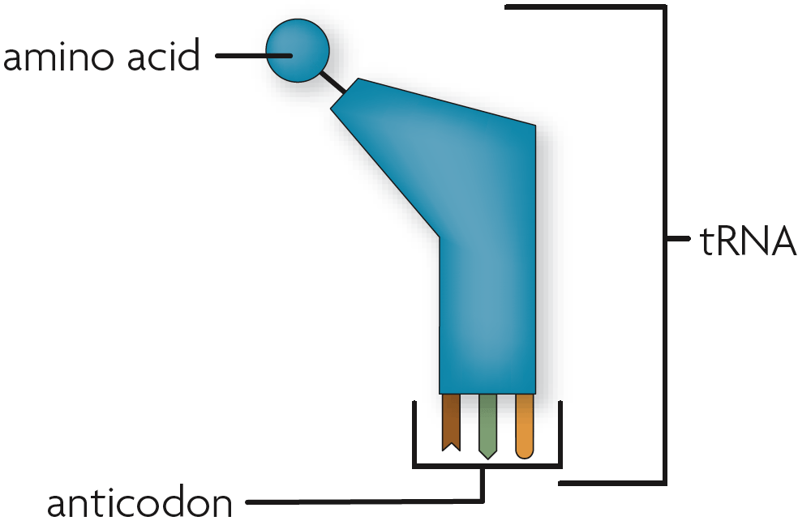
Amino acids are linked to become a protein.
An anticodon is a set of three nucleotides that is complementary to an mRNA codon.
An anticodon is carried by a tRNA.

Slide 27
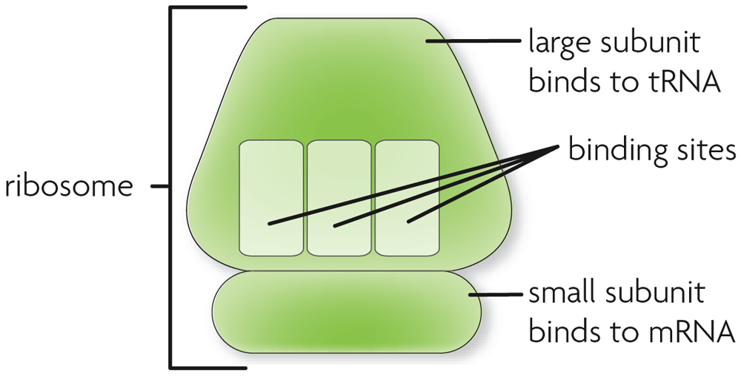
Ribosomes consist of two subunits.
The large subunit has three binding sites for tRNA.
The small subunit binds to mRNA.

Slide 28
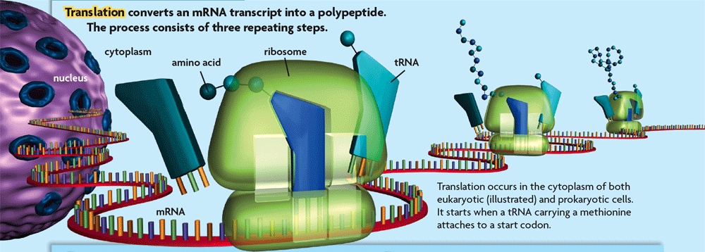
For translation to begin, tRNA binds to a start codon and signals the ribosome to assemble.
A complementary tRNA molecule binds to the exposed codon, bringing its amino acid close to the first amino acid.

Slide 29
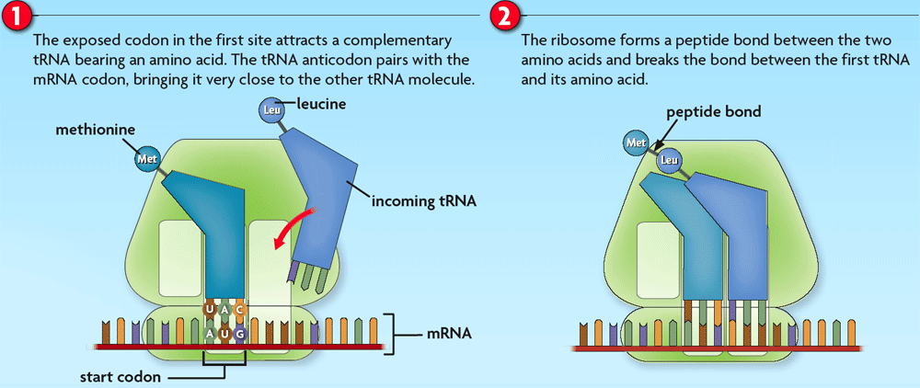
The ribosome helps form a polypeptide bond between the amino acids.
The ribosome pulls the mRNA strand the length of one codon.

Slide 30
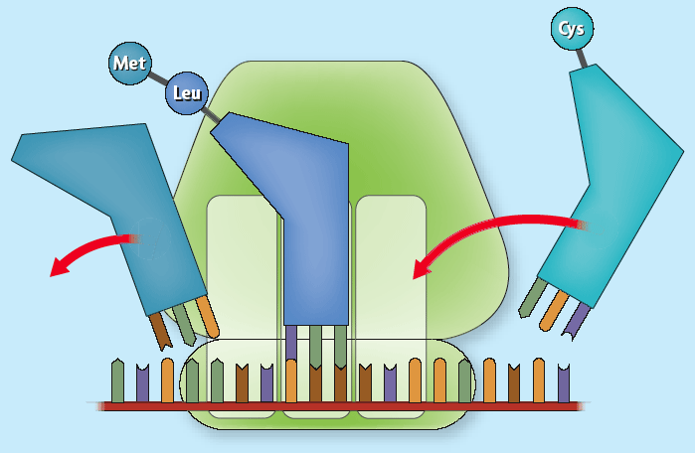
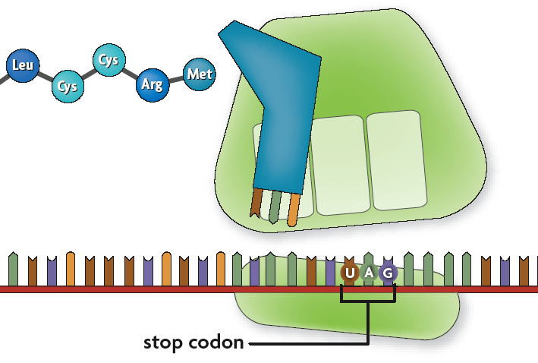
The now empty tRNA molecule exits the ribosome.
A complementary tRNA molecule binds to the next exposed codon.
Once the stop codon is reached, the ribosome releases the protein and disassembles.

