Slide 1
Glucose (C₆H₁₂O₆)
THE organic building block

Slide 2
Glucose can have a straight chain

Slide 3
Or a closed chain (ring)

Slide 4
Connect six carbons (black molecule)

Slide 5
Create five hydroxyl- groups (-OH)

Slide 6
Build six hydrogens with bonds

Slide 7
Add hydroxyl groups to five of six carbons

Slide 8
Add 5 hydrogens to same carbon as hydroxyl groups

Slide 9
Notice empty carbon has 3 holes that are not occupied

Slide 10
Add sixth hydrogen to one of the holes

Slide 11
How do you add one last oxygen molecule if there are two openings left?

Slide 12
Add two “bendy” bonds to last oxygen atom

Slide 13
Attach to last two holes to create a double bond carboxyl group

Slide 14
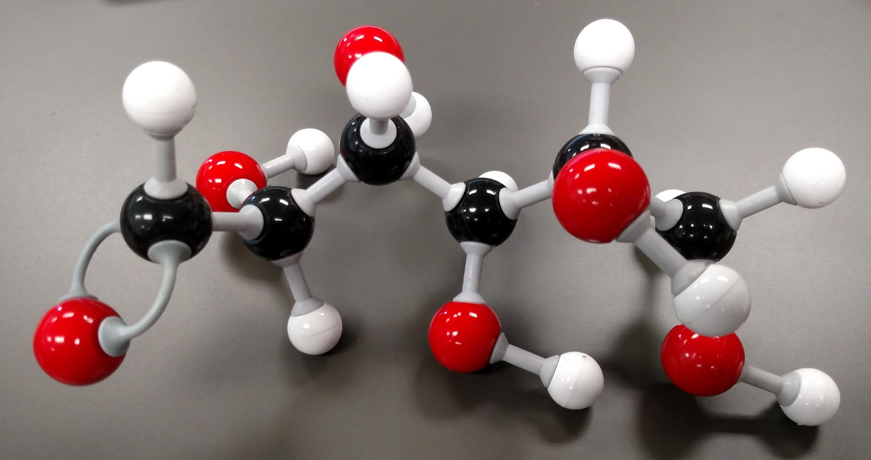
This is a molecule of glucose – C₆H₁₂O₆

Slide 15
Get two glucose molecules

Slide 16
Dehydration Rxn
Remove hydroxyl group

Slide 17
Dehydration Rxn
Remove hydrogen

Slide 18
Formation of Water (H₂O)

Slide 19
Glucose + glucose = MALTOSE + water
A disaccharide

Slide 20
Making of Amino Acid Alanine (ala)
-NH₂ = amino group
-COOH = carboxylic acid group
“R” Group

Slide 21
Notice Nitrogen has empty spot…and that’s okay!

Slide 22
Alanine zwitterion
Creates ION NH₃⁺¹
And ION –COO⁻¹

Slide 23
Serine (Ser) How is it different from ala?
R group is different (additional –OH group)

Slide 24
Alanine (ala) & Serine (ser)

Slide 25
Start of dehydration Rxn to create peptide bond

Slide 26
Removal of hydroxyl (-OH) group

Slide 27
Formation of water

Slide 28
Formation of Peptide bond

Slide 29
Ser + Ala = Ser-Ala + H₂O

Slide 30
Amino acids linked together = protein
Peptide bond

Slide 31
End of Show!

Slide 32
More sugar cartoons

Slide 33
