Slide 1
Vertebrate Tissues
Science in Motion

Slide 2
4 Basic Tissue Types
Epithelial Tissue
Protects, secretes, absorbs
Simple squamous epithelium
Simple cubodial epithelium
Simple columnar epithelium
Ciliated epithelium
Pseudostratified ciliated columnar epithelium

Slide 3
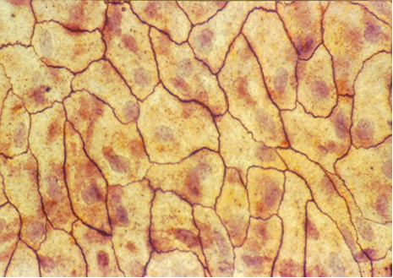
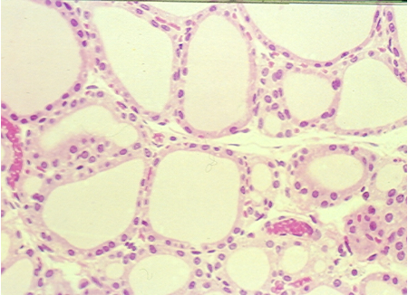
Squamous Epithelium
Simple Squamous Epithelium
Flat cells
Allows rapid diffusion of substances
Found kidney, alveoli of lungs, etc

Slide 4
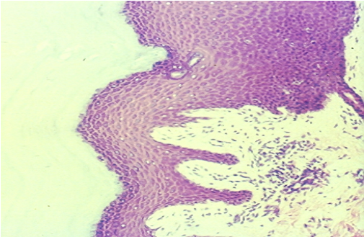
Stratified Squamous Epithelium
Basement Membrane
Composed of more than one layer of cells
Deepest layer sits on the basal surface (basement membrane)
Well suited to stress
Variations• keratinized (retards water loss, prevents penetration of disease organisms), nonkeratinized
Found • epidermal layer of skin, tongue, etc.

Slide 5
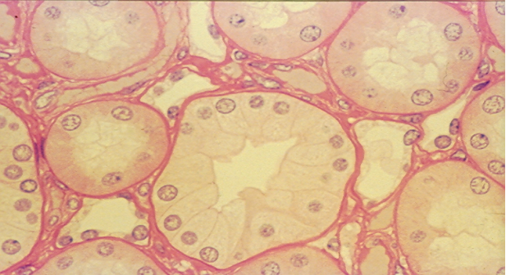
Cubodial Epithelium
Simple Cubodial Epithelium
Cube- shaped cells
Absorption & secretion
Found in liver, thyroid gland, mammary gland, salivary gland, kidney tubules, etc.

Slide 6
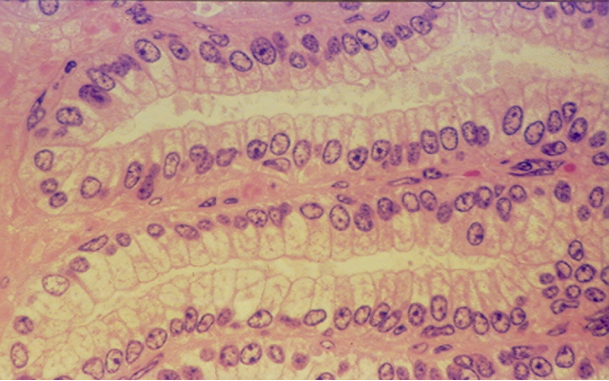
Columnar Epithelium
Simple Columnar Epithelium
Tall, narrow cells
Absorption & secretion
Found in the inner lining of the gastrointestinal tract, uterus, kidney tubes, uterine (Fallopian) tubes, etc.

Slide 7
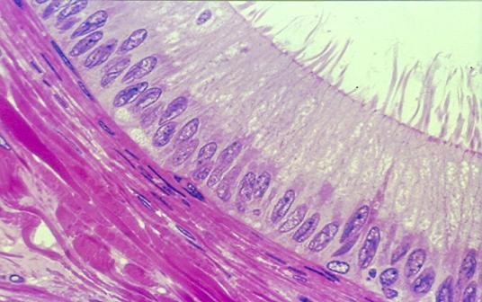
Pseudostratified Ciliated Columnar Epithelium
Goblet Cells- secrete mucus
Cilia
Basal Cells
Single row of cells- not all will reach the free surface – each cell borders the basal surface
secretes & propels
Found in trachea, etc

Slide 8
4 Basic Tissue Types
Connective Tissue
Supports, binds together, protects
Bone
Adipose Tissue
Areolar Tissue
“White” Fibrous Tissue (Tendon)
“Yellow” Elastic Connective Tissue
Cartilage• Hyaline, Elastic, Fibrocartilage
Blood• Erythrocytes, Leucocytes, Thrombocytes

Slide 9
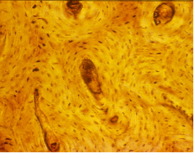
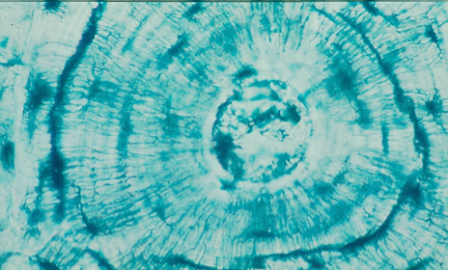
Compact Bone
Haversian Canal
Osteocytes in lacunae
Canaliculi
Calcified matrix in concentric lamellae around Haversian canal – containing blood vessels; osteocytes in lacunae between lamellae connected by canaliculi
Physical support & framework, leverage for muscles, storage of minerals
Found in skeleton

Slide 10
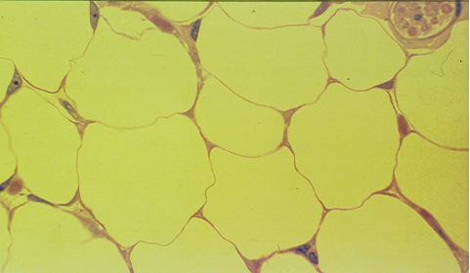
Adipose Tissue
Large, empty-looking cells (adipocytes) with thin margins; nucleus pressed against cell membrane
Stores fat, Energy storage, thermal insulation, space filled as cushioning, body contour
Subcutaneous fat beneath the skin & surrounding organs

Slide 11
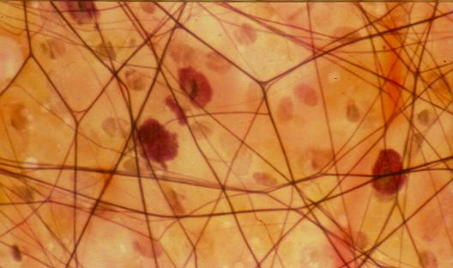
Areolar Tissue
Loose arrangement of collagen and elastic fibers, scattered cell types & abundant ground substance
Underlying all epithelia forming passageway for nerves & blood vessels; fascia between muscles

Slide 12
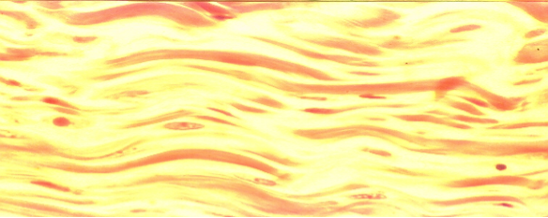
Dense Connective Tissue
fibroblasts
Densely, packed, parallel collagen fibers; compressed fibroblast nuclei & scanty open space
Few blood vessels, injuries- slow to heal
White Fibrous Tissue-• Tendons- bind muscles to bones, Ligaments- bind bones to bones
Yellow Fibrous Tissue•– found: vocal cords, vertebral column, etc

Slide 13
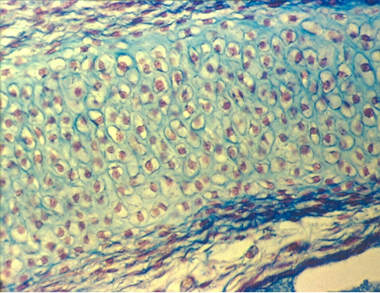
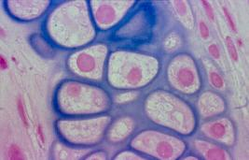
Hyaline Cartilage
lacunae
Chondrocyte
Clear, glassy matrix; fine dispersed collagen fibers; chondrocytes in small clusters enclosed in lacunae
Supports airway, eases joint movement
Found over ends of bones at movable joints; sternal ends of ribs, supportive material in larynx, trachea, bronchi; fetal skeleton; end of the nose

Slide 14
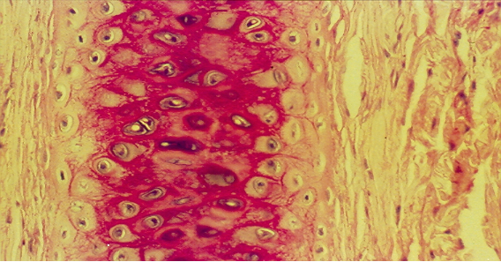
Elastic Cartilage
Chondrocyte
Lacunae
Web-like mesh of elastic fibers
Provides flexible, elastic support
External ear and epiglottis

Slide 15
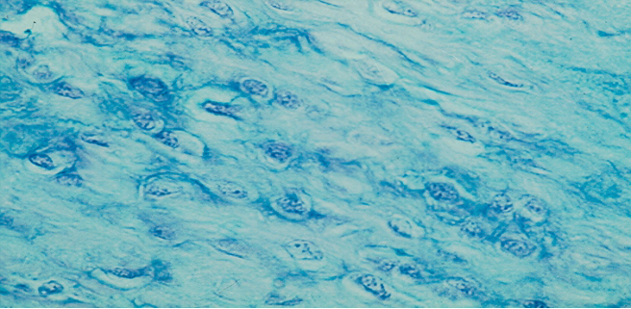
Fibrocartilage
lacunae
chondrocyte
Cartilage containing parallel collagen fibers
Resists compression and absorbs shock in some joints
Found in meniscus of knee, intervertebral discs of the vertebrae, etc.

Slide 16
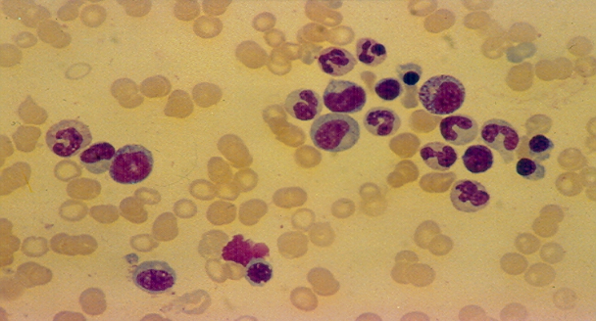
Blood
Leucocytes
Erythrocytes
Thrombocytes
Erythrocytes (Red blood Cells)- contain hemoglobin which allows for transportation of oxygen, anucleated, disc-shaped cells
Leucocytes (White Blood Cells) – large, nucleated cells, help to fight infection, 5 different types – each type distinguished by shape of the nucleus
Thrombocytes (Platelets)- fragments of a cell, functions in blood clotting

Slide 17
4 Basic Tissue Types
Muscle Tissue
Movement
Moving body parts, such as the muscles of arms, legs
Moving substances throughout the body, such as the muscles that make up the blood vessels
Striated (Skeletal) Muscle
Visceral (Smooth) Muscle
Cardiac Muscle

Slide 18
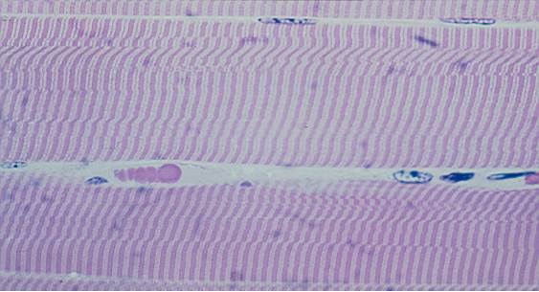
Striated (Skeletal) Muscle
striations
Unbranched, multi-nucleated fibers bound together in bundles
Voluntary muscle, allows for movement
Found: along the bones

Slide 19
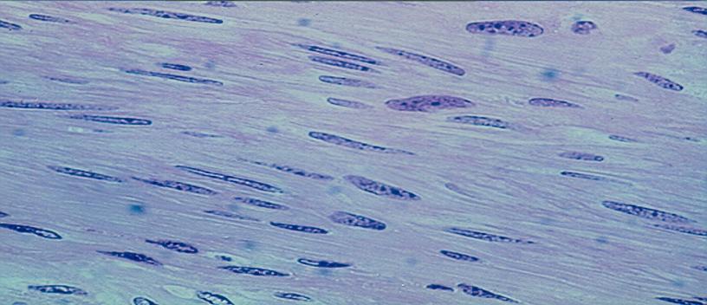
Visceral (Smooth) Muscle
Spindle-shaped fibers(cells)
Unbranched, unstriated, uninucleated fibers(cells)
Found: internal (visceral) organs- such as esophagus, intestines, stomach, glands, etc.

Slide 20
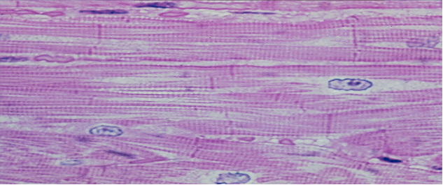
Cardiac Muscle
Intercalated disc
Branched, involuntary, striated, multinucleated fibers
Has intercalated discs
Found: Heart

Slide 21
4 Basic Tissue Types
Nerve Tissue
Coordination, communication, integration
Neuron
Dendrites- transport impulses toward the cell body
Axons – transport impulses away from the cell body
Cell body – interprets, coordinates

Slide 22
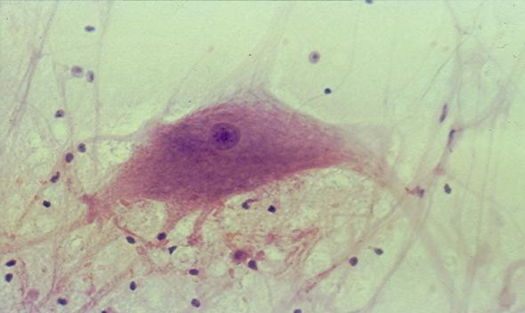
Nerve Tissue
Cell Body
Axon
Dendrites
Made up of neurons (nerve cells)
Located in brain, spinal cords, nerves

